Slide 1
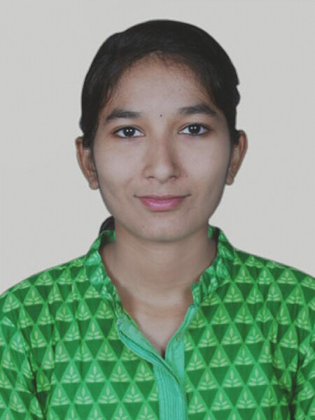

Assignment No. 3 COUNTRY REPORTS
Name: Utkarsha Wasudeo Kurekar
PRN: 19020448107
Course: MBA(E) 19-21 B_Weekend
Subject: Global, Political and Business Economy
Semester: II
Country: Italy

Slide 2
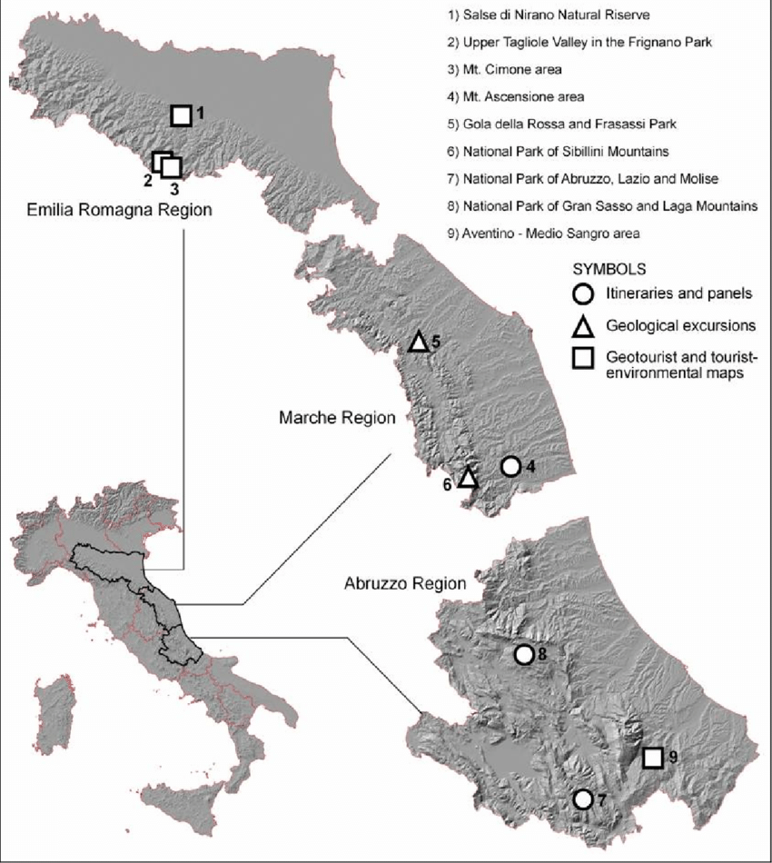
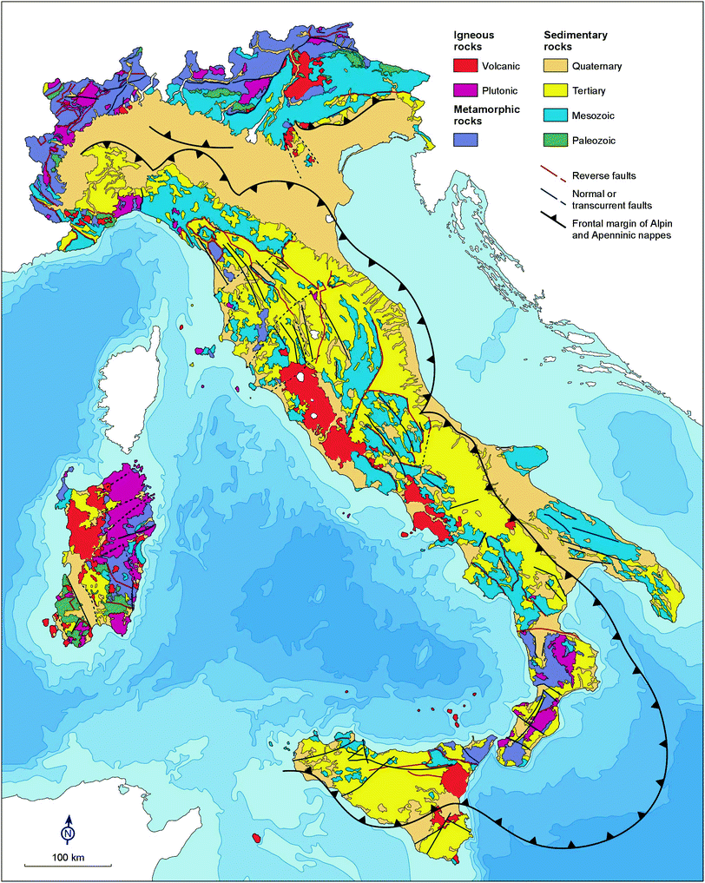
Geological aspects of Italy:-
The Park of Gola della Rossa and Frasassi
(5 in figure 1)
has been considered an economical resource.

Slide 3
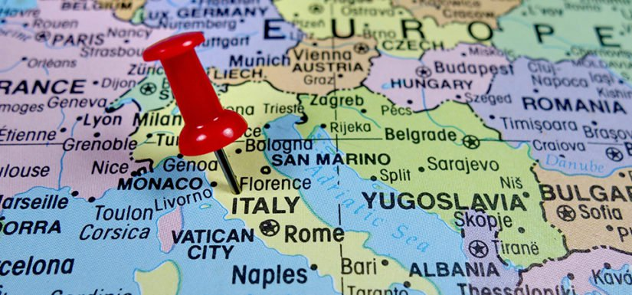
Geographical advantages of Italy:
The timber river flows from the mountains in center of Italy.
Italy is located on the Mediterranean sea
In the protection of the hills and mountains found in the peninsula.
Soil is very fertile (nitrogen, phosphorus, and potassium) advantageous for agriculture.
Italy has huge contributions to-
Worlds of art & Architecture,
Fashion & Film
Opera & Literature,
Design & Numerous of food delicacies.

Slide 4
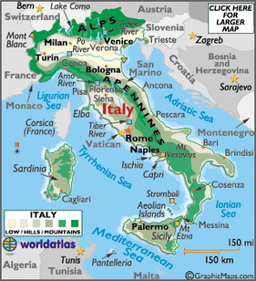
The major rivers that lie in Italy would be the Po River, the Arno River, and the Tiber River and thus Italy is known for its soil fertility and its diversity of cultural heritage
As Italy is located in the center of Mediterranean sea, it opens trade and travel with various countries.
Sea provides them food and also it is easier to locate any enemy coming via sea

Slide 5
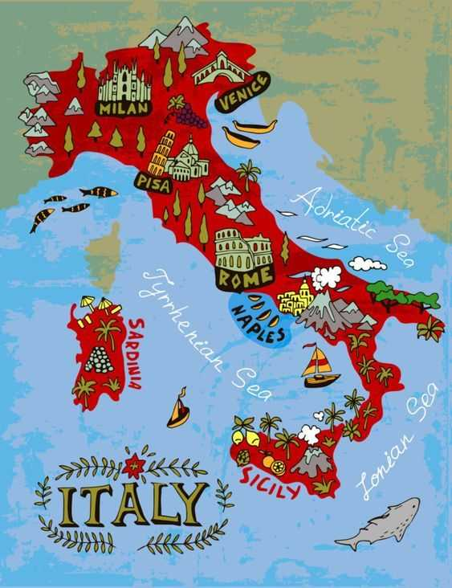
Italy is a volcanically active country
Three of Italy's volcanoes have erupted in the last hundred years:
Mount Etna, on Sicily (continuous activity)
Stromboli, one of the Aeolian Islands (continuous activity)
Mount Vesuvius, near Naples (last erupted in 1944); the only active volcano in mainland Europe.

Slide 6
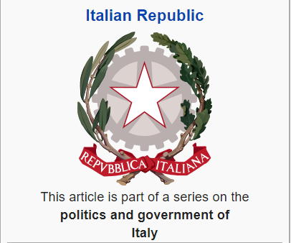
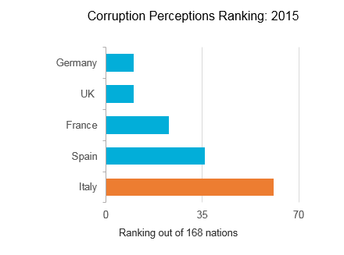
Political
Italian economy remains burdened by political interference:-
Bureaucracy,
Corruption,
High levels of taxation,
Rigid labor market,
Ineffective judicial system,
Complex regulatory framework
High cost of conducting business.

Slide 7
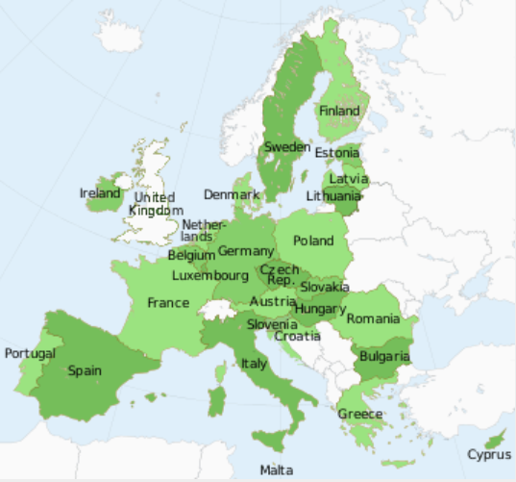
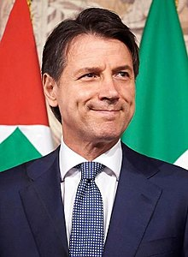

Italy is a member country of the EU since January 1, 1958 with-
Geography- 302,073 km², and Population- 60,795,612 noted on 2015
According to ASEAN, Italy is 14th largest partner in terms of exports, imports, and foreign investments in 2018
List of prime ministers of Italy
Mario Monti, 2011–2013
Enrico Letta, 2013–2014
Matteo Renzi, 2014–2016
Paolo Gentiloni, 2016–2018
European members of EU
Giuseppe Conte 2018-till the present date

Slide 8
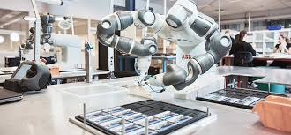
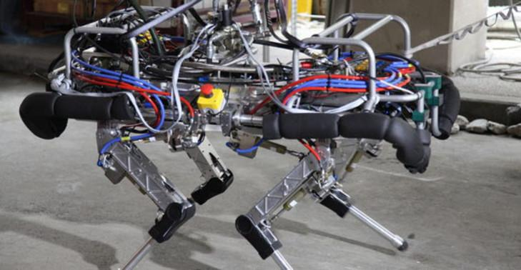
Technological-
Europe’s second-largest manufacturing economy
Italy is leading in many aspects of the Fourth Industrial Revolution.
A European leader in robotics: Will produce 8,500 units by the end of 2020 on second place following Germany who produces 20,000 robots annually with $9.6 billion in Italian export to US alone
The country has gained 10 notches and reached the 45th position in the Networked Readiness Index (NRI),

Slide 9
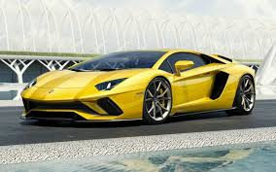
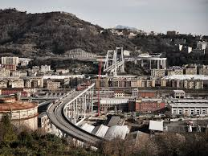

Startup in Italy – clothing & fashion, furniture, automation technology & mechanics, food and wine industry.
But weaknesses is in infrastructure and education
Italian cars- Ferrari, Lamborghini and Maserati.
Robust European tech force- Around 5,400 high-tech manufacturing companies, ranking within one of the 4 top countries

Slide 10
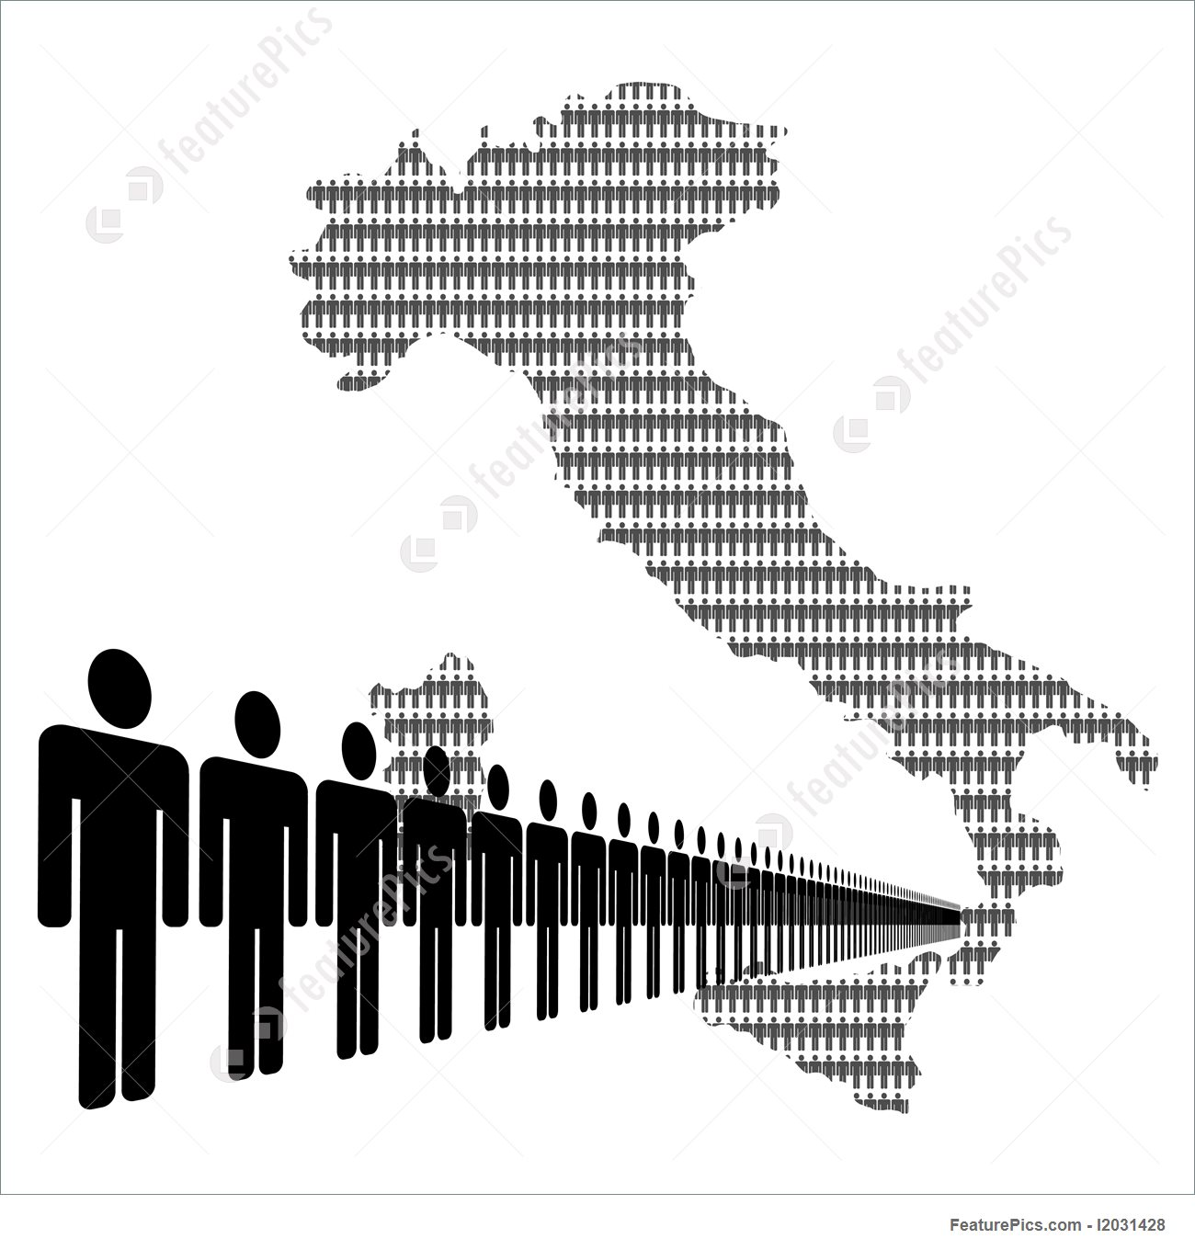
Workforce:-
Italy’s powerful economy is also supported by an educated and efficient labor force
In the Q2 of 2011, around 12.5 million employees worked in Northern Italy,
compared to 5.23 million in the Central part of the country and 7.228 million in the South.
According to the latest data, immigrants represent 11% of Italy’s workforce

Slide 11
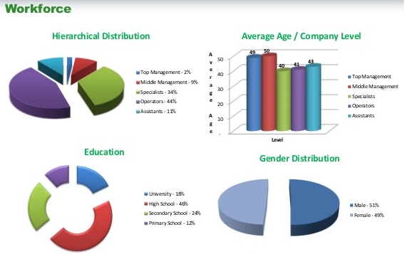
It is said that, approximately 23.35million of labour power is available in Italy.
Survey of 2016 states that there are around-
2% of top management ageing above 49 years
44 % i.e. Higher number of operations workforce of avg age 41 years

Slide 12
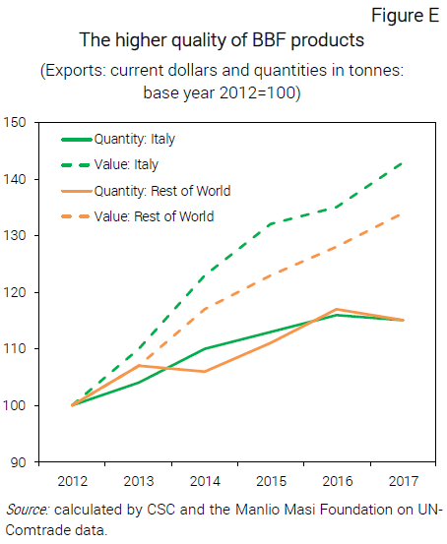
QUALITY over QUANTITY
BBF - “bello e ben fatto” products means “Beautiful and well-made” products are the Italian products that are grabbing most of the markets in the world.
The most potential markets are
China (175 million), India (70 million), Russia (30 million), Brazil (28 million) and Indonesia (23 million).
Overall, the market consists of more than 460 million potential consumers

Slide 13
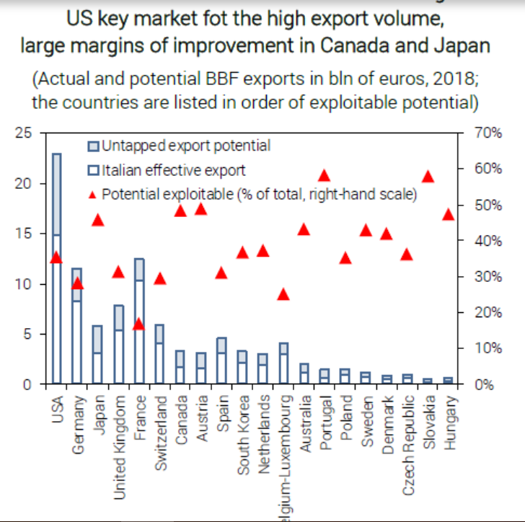
The main feature of BBF products:-
High quality materials
Careful manufacturing
Quality design
Recognizable, as production in Italy
This feature is strategized to-
Enhance value by keeping quality before quantity
Standardization of products, highlighting it feature and
perceived differently with commodity classification.
This will result in-
Beauty is reflected with better quality with consumers
willing to pay higher prices for BBF products.
The United States is the market with the highest potential
in absolute terms, with €8.2 billion
in potential additional exports

Slide 14
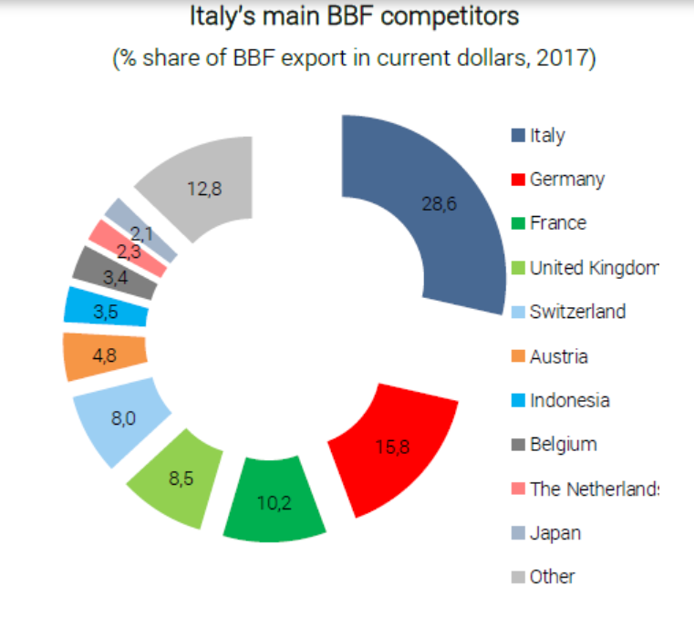
The main competitors of Italy in terms of BBF products are-
Germany with 16.8 % share
France with 10.2% share
United kingdom with 8.5% share
And others with 12.8% share
Competition from emerging Asian countries such as
China or Vietnam, which in recent years has posed
a big challenge for Italy’s productive system,
is less significant vis-à-vis BBF products.
However, this situation may change:
if Asian producers are able to improve the quality of their
exported products, and start to directly compete in
BBF market segments, their already developed presence in
destination markets could serve as a significant advantage.

Slide 15
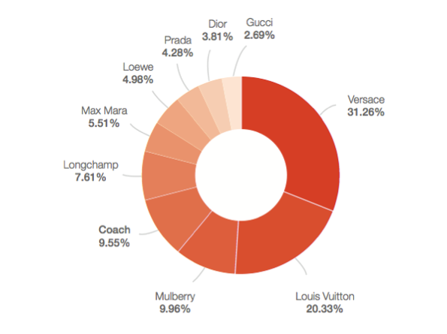
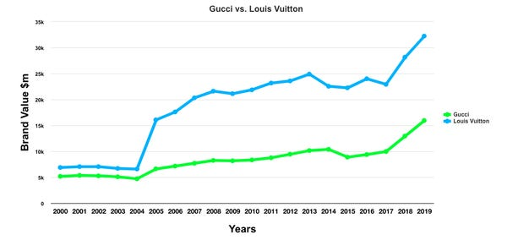
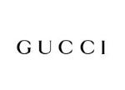
Contractual Manufacturing: Joint venture of Gucchi with Murjani Group
Italian fashion brands are well known in the world.
Brands like Valentino, Gucci, Armani, Prada, FILA, Diesel are some of the top selling brand in developing countries with huge possibilities of contract manufacturing in developing countries.
Gucci Group N.V is a multi-brand luxury goods company which has a market capitalization of $14.37 billion. Gucci entered into the Indian market through a Joint Venture with the Murjani Group and opened its boutiques in all Tier 1 cities of India.

Slide 16
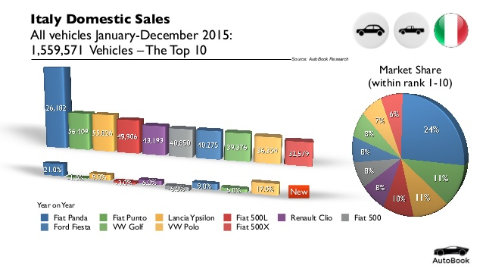
Fiat India Automobiles Limited is a subsidiary of Fiat SpA which has a market capitalization of 5.61 billion euros. The company is Italy's largest automobile manufacturer and is actively involved in designing, producing and selling vehicles.
Fiat brand in India was earlier represented through a joint venture company called Fiat India Automobiles Pvt Ltd. Even today the Tata Fiat JV plant operates under the FIAL name, as an independent entity and it produces Fiat & Tata brand cars for FCAIPL (Fiat India NSC) & Tata Motors respectively.

